Slide 1
Contextualization and Design Lightning Talk
sdmay25-26 Bryce Rega, Marek Jablonski, Gavin Patel, Jonah Frosch, Long Yu
Cost-Effective and Easily Configurable High Voltage Motor Controllers for Automotive Use
November 7th, 2024
Nathan Neihart (neihart@iastate.edu), Huang Cheng (chengh@iastate.edu)

Slide 2
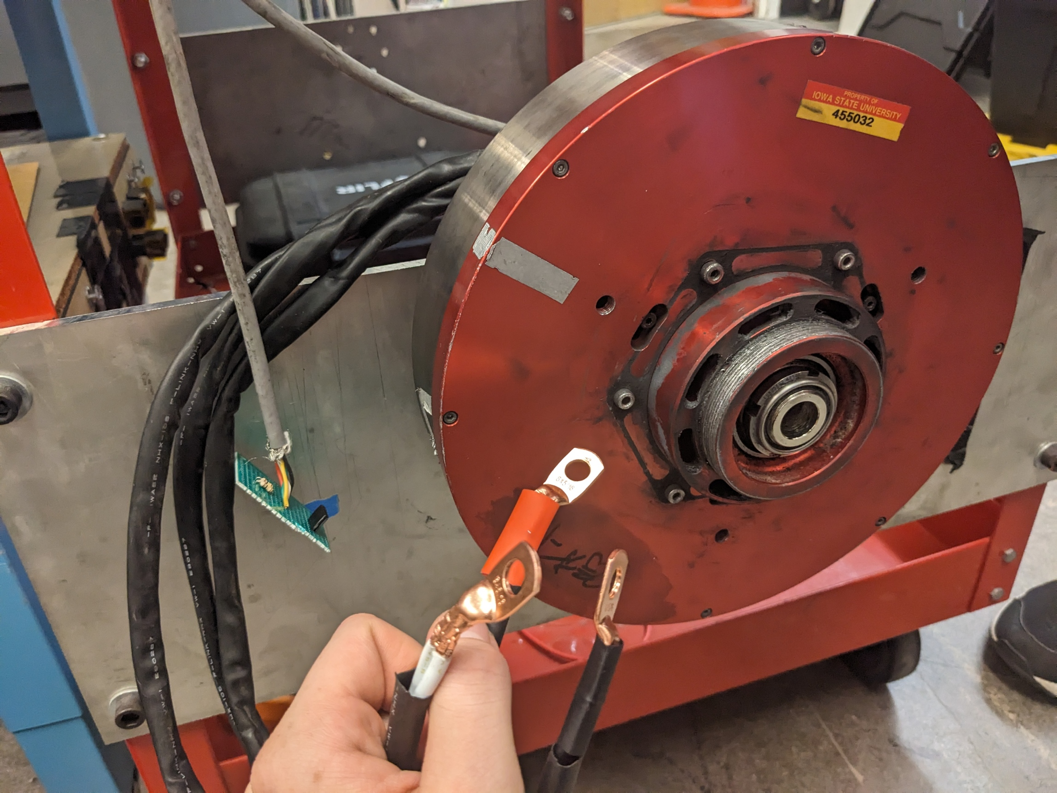
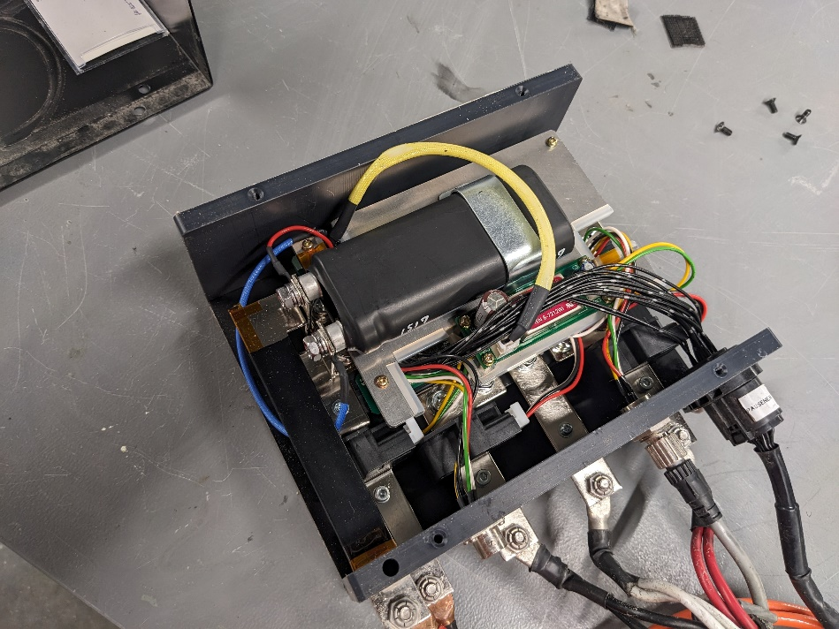
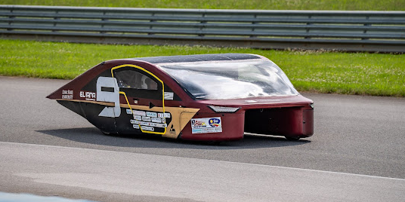
Project Background
Collegiate Solar Cars use relatively unique electric motors
Low RPM (0-1000)
High Torque (Direct Drive)
High/Medium Voltage (48-135V)
Medium Power (Peak ~7.5KW)
Problem: Existing controllers
Are very expensive (~$5k each)
Black boxes to those who use them
Notorious for having issues.

Slide 3
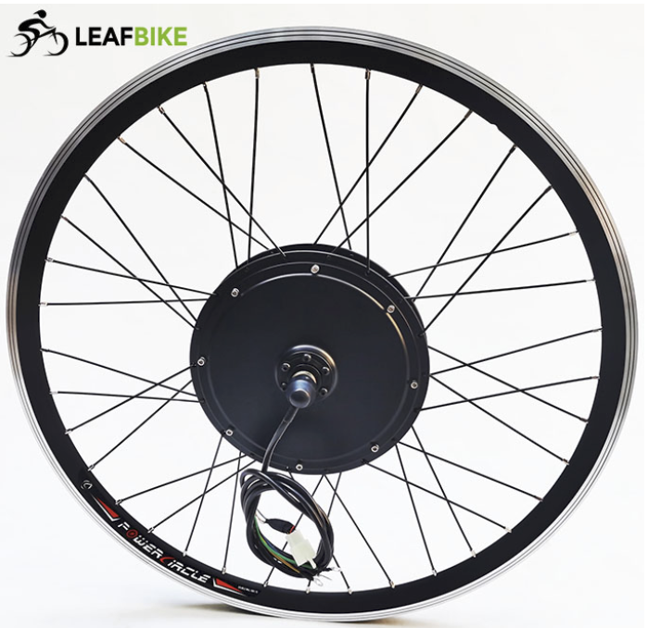
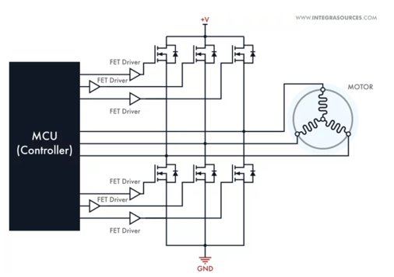
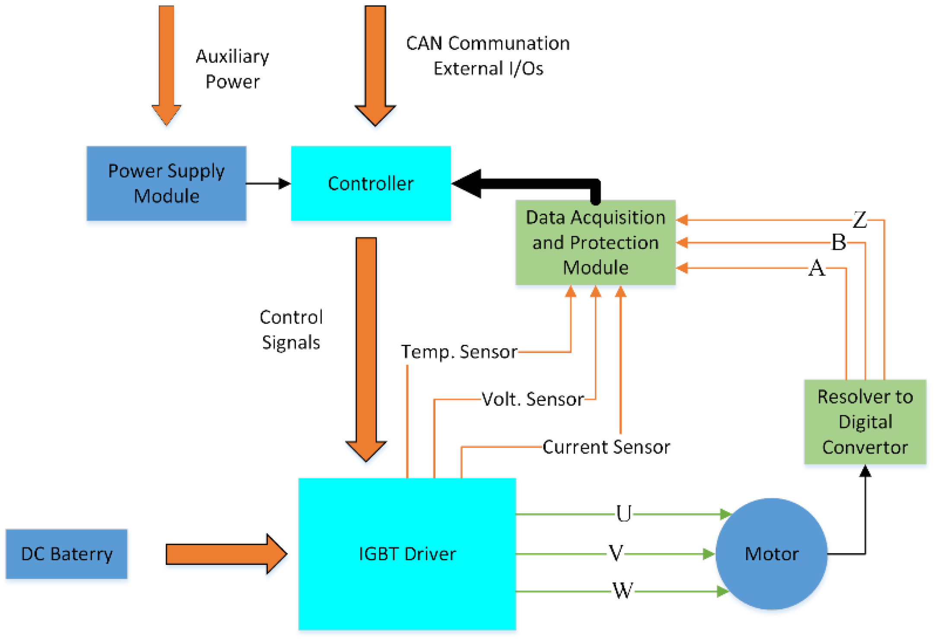
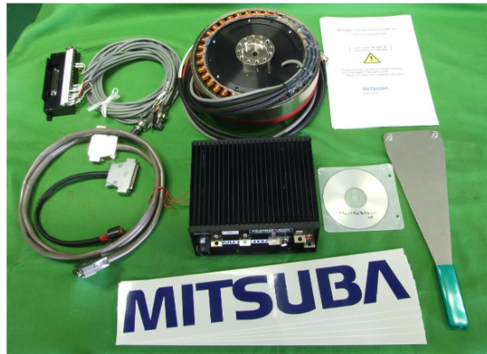
Project Overview
Custom High Voltage Motor Controller
Architecture and Implementation from the ground up
Low total cost for controller when compared to market options
Develop a GUI for interfacing and configuring controller
Compatible with different similar motors

Slide 4
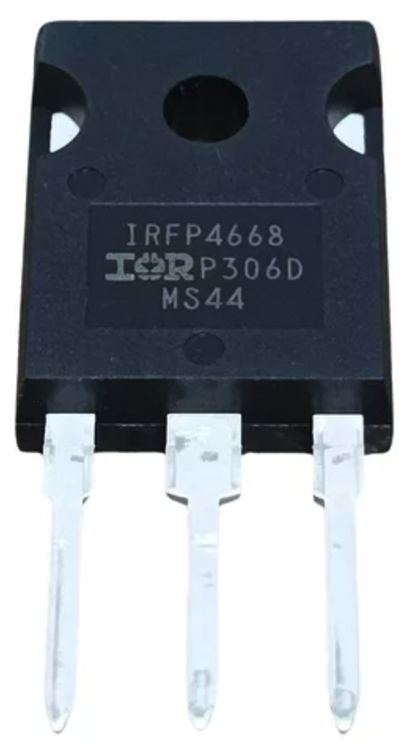
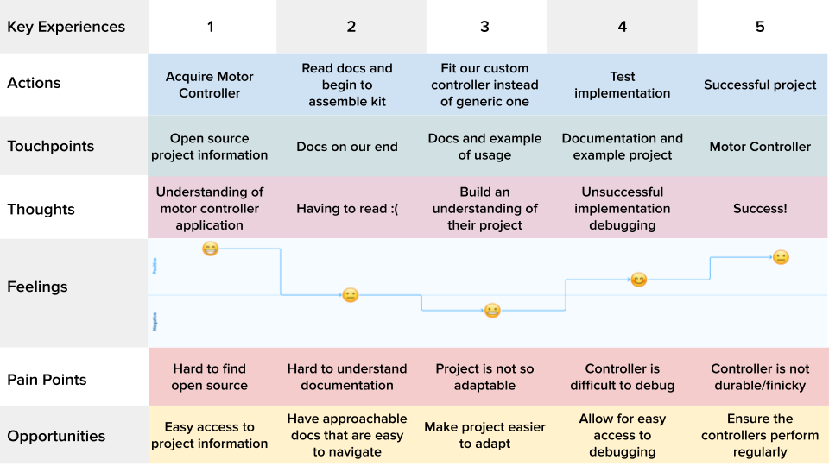
Artifacts – Journey Maps
Include each of the artifacts developed as a team in class (journey map, pros/cons table, and technical complexity analysis). Individually reflect on the current suitability of your design solution in human, technical, and economic areas using the following questions.
Can we get an IGBT vs MOSFET thing in here?
IRFP4668
Can we get something other than this table?TO
Jonah, a DIY e-bike user
An engineer on a solar car team

Slide 5
Artifacts – Pros & Cons
ATSAMC21 | STSPIN32
Supports CAN | No CAN support
3 timers w/ motor PWM features | One timer handles all PWM
Needs external gate drivers | Built-in gate drivers
Supported by PRISUM software environment | Supported by ST environment
No USB support | No USB support

Slide 6
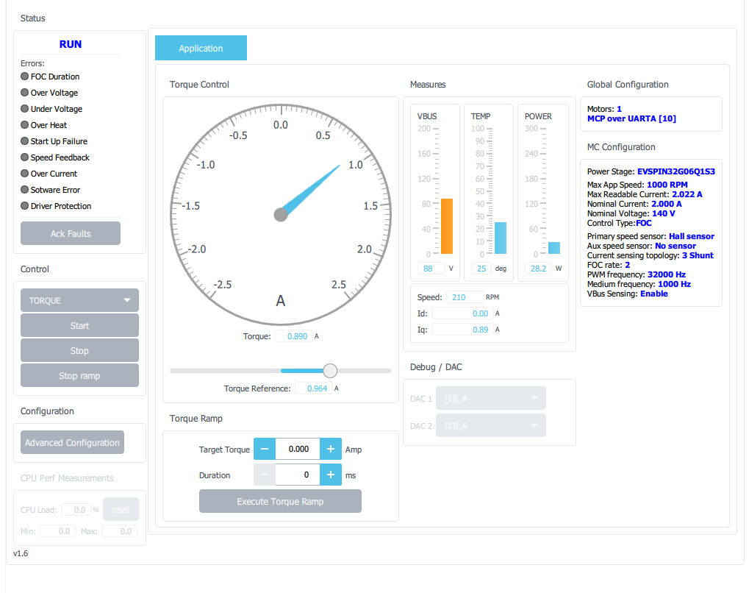
Human
Configurability is everything
Looking to add more config options after using development board configurations
Controlling and monitoring via CAN as well as other communication options
Custom CAN IDs let solar car teams "plug and play" into their system
Analog and GPIO connections may be easier for electric bikes
Interface for configurations and monitoring should be easy
Development board had a GUI with useful information we may want to mimic
Mitsuba GUI is difficult to use and frustrating—learning from their mistakes
Screenshot of Mitsuba controller interface

Slide 7
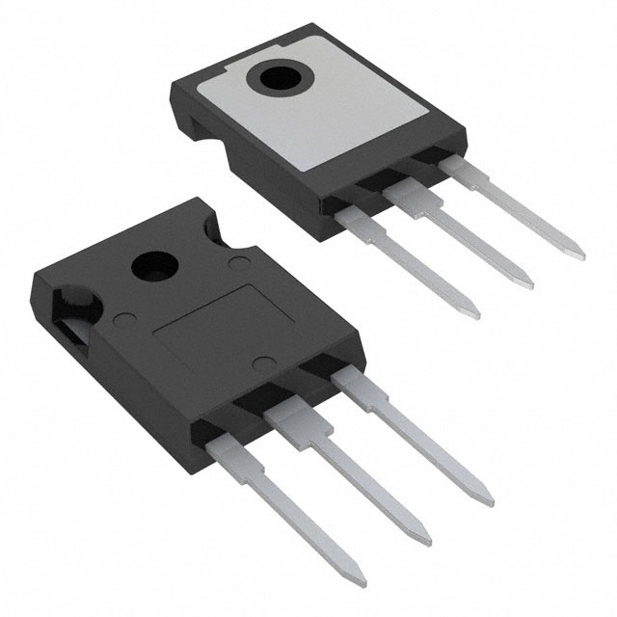
Economic
Describe the ways in which your solution improves upon existing solutions. Describe any drawbacks of your solution. Either justify the drawbacks or propose ways to mitigate or eliminate those drawbacks.
Discuss the expense of IGBT and MOSFET
Describe how this is great for larger automotive stuff, like solar cars
Point out how it is a bit more expensive that some ebike solutions, but that the customizability may justify the cost.
Three main elements gaps in existing solution:​ low cost, high performance, user friendly interface.
MOSFETS over IGBT, reliable switching for high current while more efficient.
Cost around 5 dollars for each MOSFET driver.
High power and high efficiency for larger automotive cars.
Our solution comes with a higher cost compared to other e-bike solutions, but is much more configurable.
Allows users to customize to fit their wants and optimize based on their needs

Slide 8
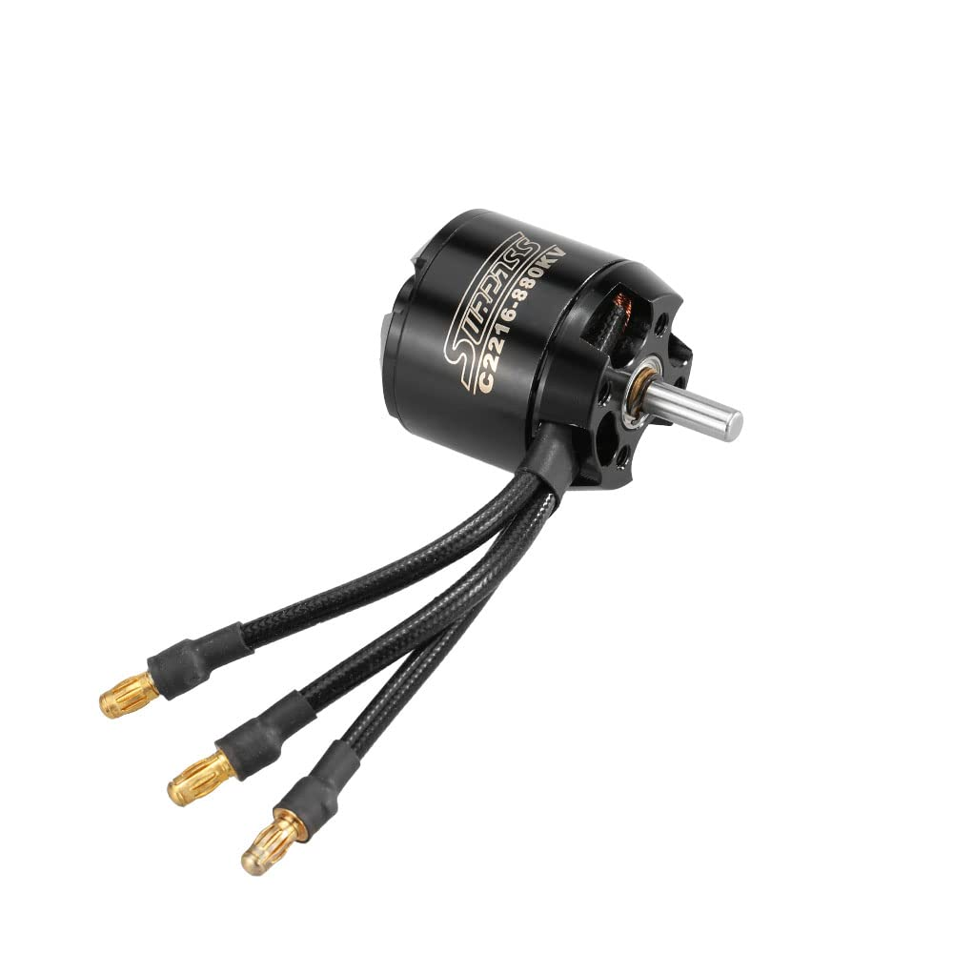
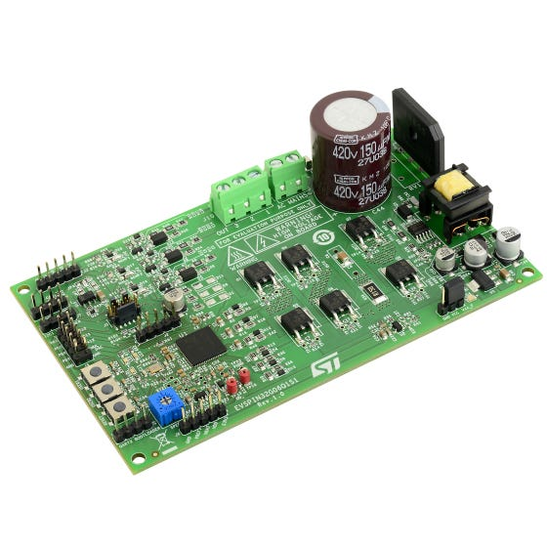
Functionality
Our design will function by spinning the motor that it is connected to in proportion of the input throttle.
User input is received via either CAN bus communication or GPIO, which is configurable in the device settings.
The device will also operate based on feedback from the HALL sensor, which will provide information on the motor, such as its current speed. This will be used in order to more accurately drive the motor and for cruise control.

Slide 9
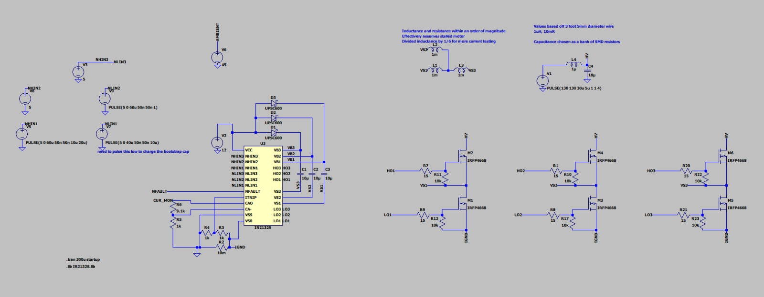
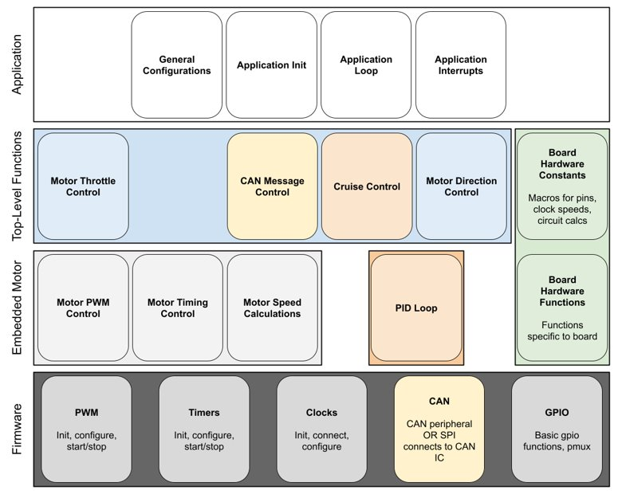
Technical
Internal complexity: design advanced circuitry, motor control, and CAN bus.
These allow for high power, precise motor control, and configuration flexibility.
Advanced Motor control theory including feedback control loops, phasor transforms and integrated protections.
External complexity: user-friendly, straight-forward configuration options. Meeting industry standard specifications
Multiple hardware design iterations and software revisions are expected with the gained knowledge per attempt.

Slide 10
Conclusion
We are developing the hardware and software for a highly configurable motor controller. This solution fits both the human and economical requirements expected by our end users. This comes with significant technical complexity regarding motor controller theory and power electronics.

